Slide 1

WELCOME
everyone

Slide 2



Humber College
Humber College
Flight Price Prediction
Guided By:
Dr Ibrahim Tamim
Presented by:
Nevin Toms

Slide 3

Agenda
1
Understanding the Problem
2
Methodology Block Diagram
3
About Dataset
4
Exploratory Data Analysis
5
Feature Engineering
6
Model Comparison
7
Hyperparameter Optimization

Slide 4
Agenda
1
Understanding the Problem
2
Methodology Block Diagram
3
About Dataset
4
Exploratory Data Analysis
5
Feature Engineering
6
Model Comparison
7
Hyperparameter Optimization

Slide 5
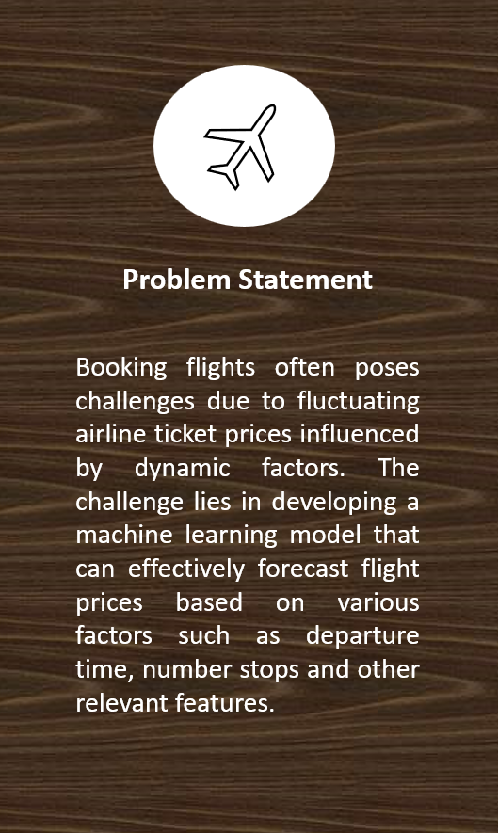
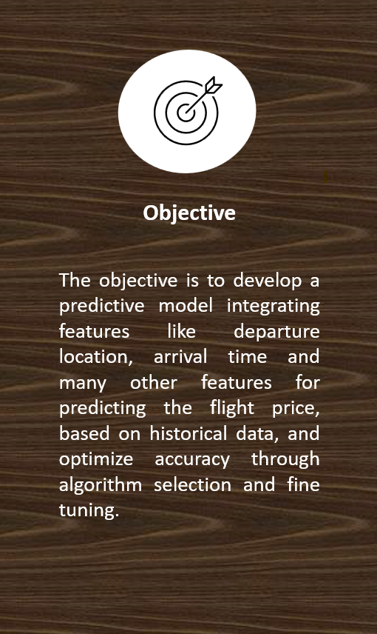
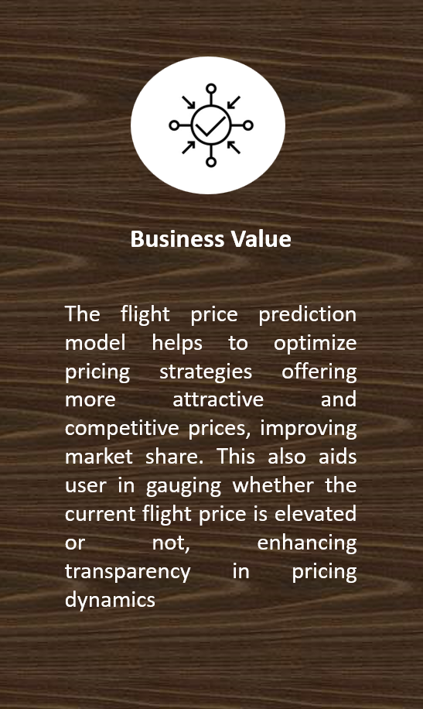
Problem Statement

Slide 6
Objective

Slide 7
Business Value

Slide 8
Methodology Block Diagram
Kaggle
Flight Ticket Price
EDA
Data Collection
User Input
Best Model
(Departure time, Arrival time, Source, Destination, Number of stops, Airline)
Data Cleaning
Combining economic and business class
Hyperparameter Optimization
Check the dataset for null values
Dropping the columns having non-impacting information
Model Evaluation
Data Preprocessing
Feature Engineering
Model Training
Performing One Hot Encoding on Nominal Categorical Data
Converting the data type to the required format
(MLR, LR, RR DT, RF, XGBoost , SVM, MLP)
Performing Label Encoding on Ordinal Categorical Data
Extracting new features from the existing features
Normalizing the features
Binning to reduce the number of columns

Slide 9
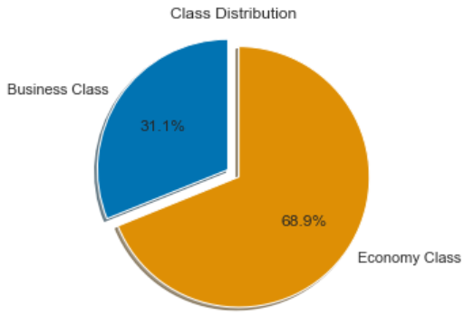
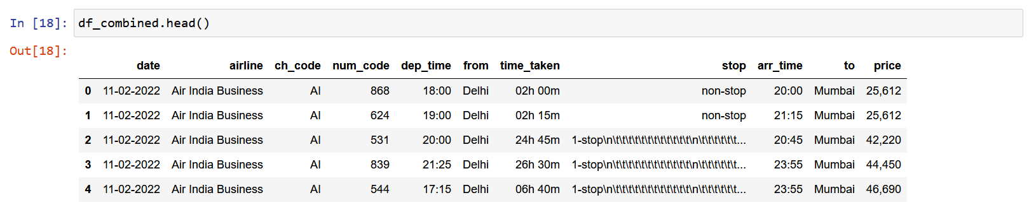
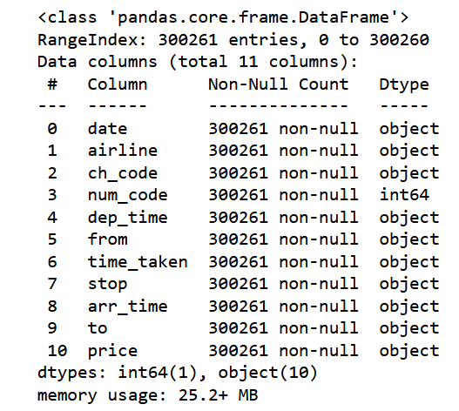
Dataset at a glance
There were two different datasets - Economy class and Business class.
The business class consists of 93,484 records and 11 features.
The economy class consists of 206,774 records and 11 features.
Observations:
The features “date”, “dep_time”, “arr_time” needs to be converted to date time column.
The “time_taken” is in a string format, which needs to converted to integer type.
“stop” and “price” needs pre-processing and conversion to integer type.
Most of the columns are categorical and needs to be treated.

Slide 10
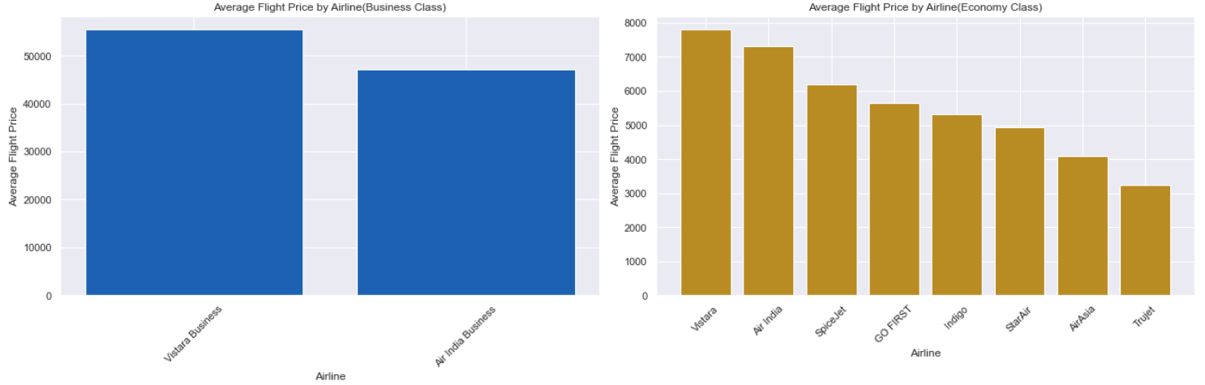
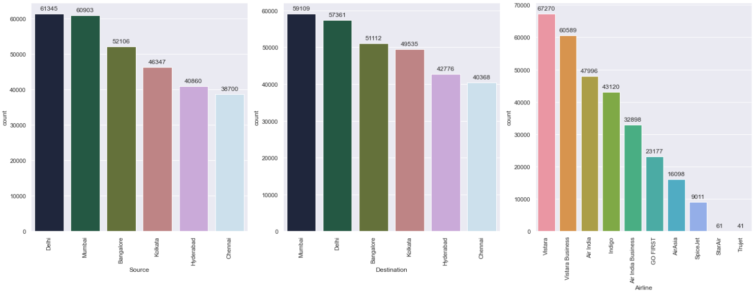
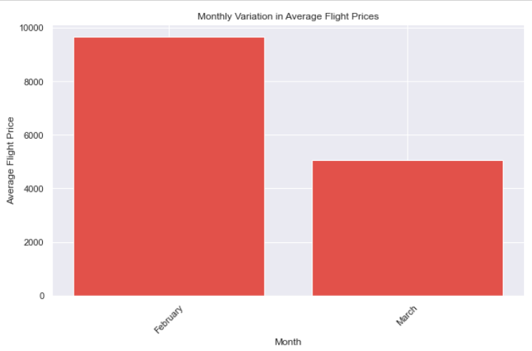
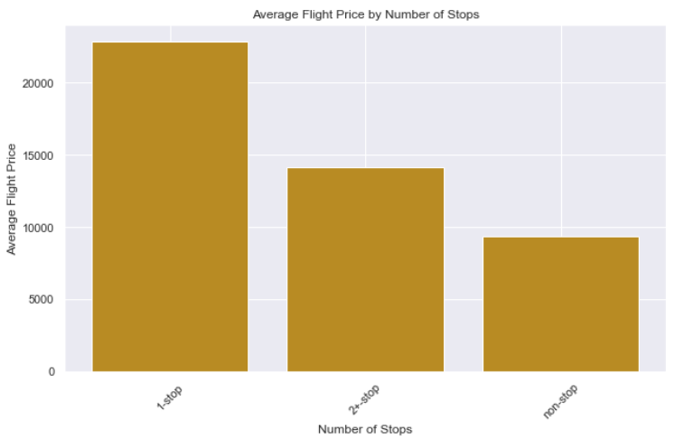
Exploratory data analysis
Airline
There are 8 unique airlines in the dataset.
Vistara is the most preferred airline with the highest row count and is the most expensive airline both in business and economy class.
Count of SpiceJet, StarAir and Trujet is quite low. They have comparatively low average ticket price when compared with other airlines in the economy sector.
Monthly Variation of flight prices
The dataset contains only two travel months i.e. February and March.
February has higher average flight price than March.
Flight Price Variation by Stops
Flight prices vary with the number of stops.
“non-stop” flights are having the lowest average ticket price.

Slide 11
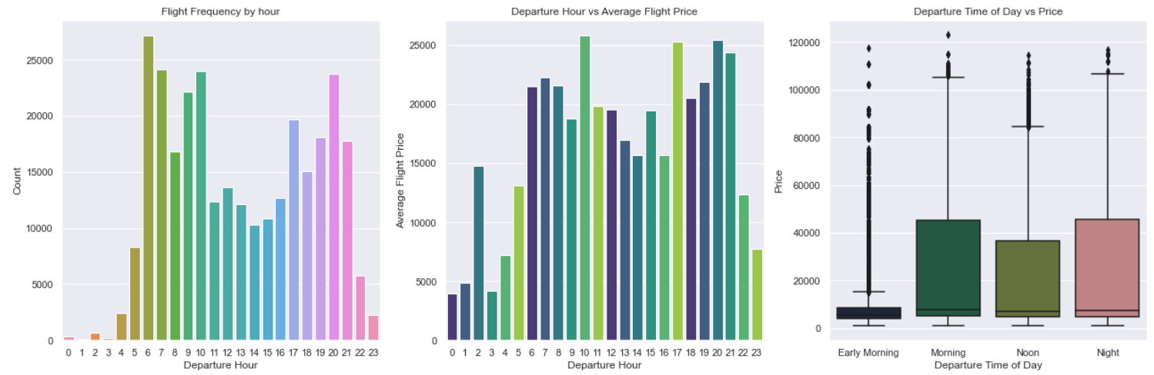
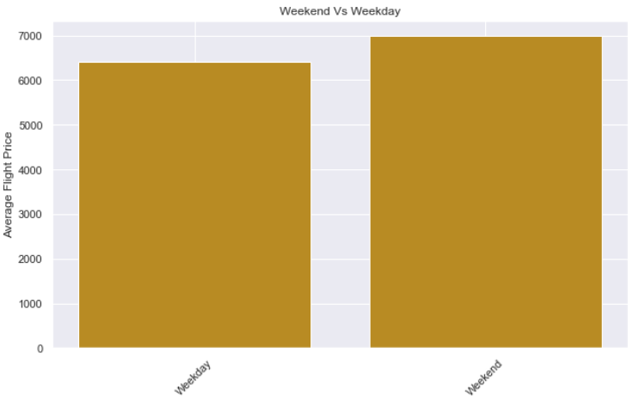
Feature Engineering
Time_of_Day:
To prevent having 24 columns from one hot encoding of the departure hour, it was divided it into 4 categories.
0 - 5: Early Morning
6 - 11: Morning
12 - 17: Noon
18 - 23: Night
Weekend:
Average flight price seems to be higher in weekends compared to weekday.
Explicitly mentioning that this is a weekend or not can help model predict better results.

Slide 12
Model Comparison
TIME
MAE
R2 SCORE
0.91 | 4266 | 473ms
0.91 | 4265 | 14s
0.91 | 4265 | 170ms
0.95 | 2392 | 3s
0.96 | 2318 | 3min
0.96 | 2354 | 2s
0.83 | 5562 | 1h 19min
0.97 | 2315 | 39min
Multi Linear Regression
Lasso Regression
Ridge Regression
Decision Tree
Random Forest
XGBoost
Support Vector Machine
Multi Layer Perceptron

Slide 13
Model Comparison
0.91 | 4266 | 473ms
0.91 | 4265 | 14s
0.91 | 4265 | 170ms
0.95 | 2392 | 3s
0.96 | 2318 | 3min
0.96 | 2354 | 2s
0.83 | 5562 | 1h 19min
0.97 | 2315 | 39min
R2 SCORE
MAE
TIME
Multi Linear Regression
Lasso Regression
Ridge Regression
Decision Tree
Random Forest
2
XGBoost
3
Support Vector Machine
Multi Layer Perceptron
1

Slide 14
Model Comparison
0.91 | 4266 | 473ms
0.91 | 4265 | 14s
0.91 | 4265 | 170ms
0.95 | 2392 | 3s
0.96 | 2318 | 3min
0.96 | 2354 | 2s
0.83 | 5562 | 1h 19min
0.97 | 2315 | 39min
R2 SCORE
MAE
TIME
Multi Linear Regression
Lasso Regression
Ridge Regression
Decision Tree
Random Forest
2
XGBoost
3
Support Vector Machine
Multi Layer Perceptron
1

Slide 15




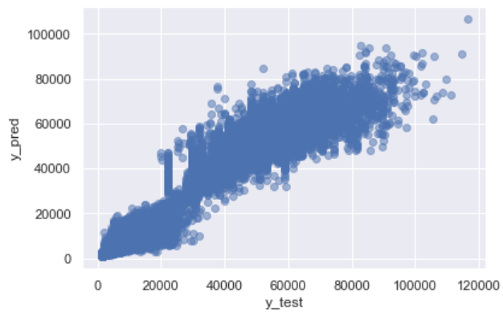
Hyperparameter Optimization (RF)
run.optimize()
Hyperparameters
Best Hyperparameters
Score
n_estimators: [50, 100, 200]
n_estimators: 200
MAE: 2200
R2 Score: 0.97
max_depth: [None, 10, 20, 30]
max_depth: 20
min_samples_split: [2, 5, 10]
min_samples_split: 2
min_samples_leaf: [1, 2, 4]
min_samples_leaf: 4
max_features: [sqrt, log2, 1.0]
max_features: 1.0

Slide 16




Thank You

